Slide 1


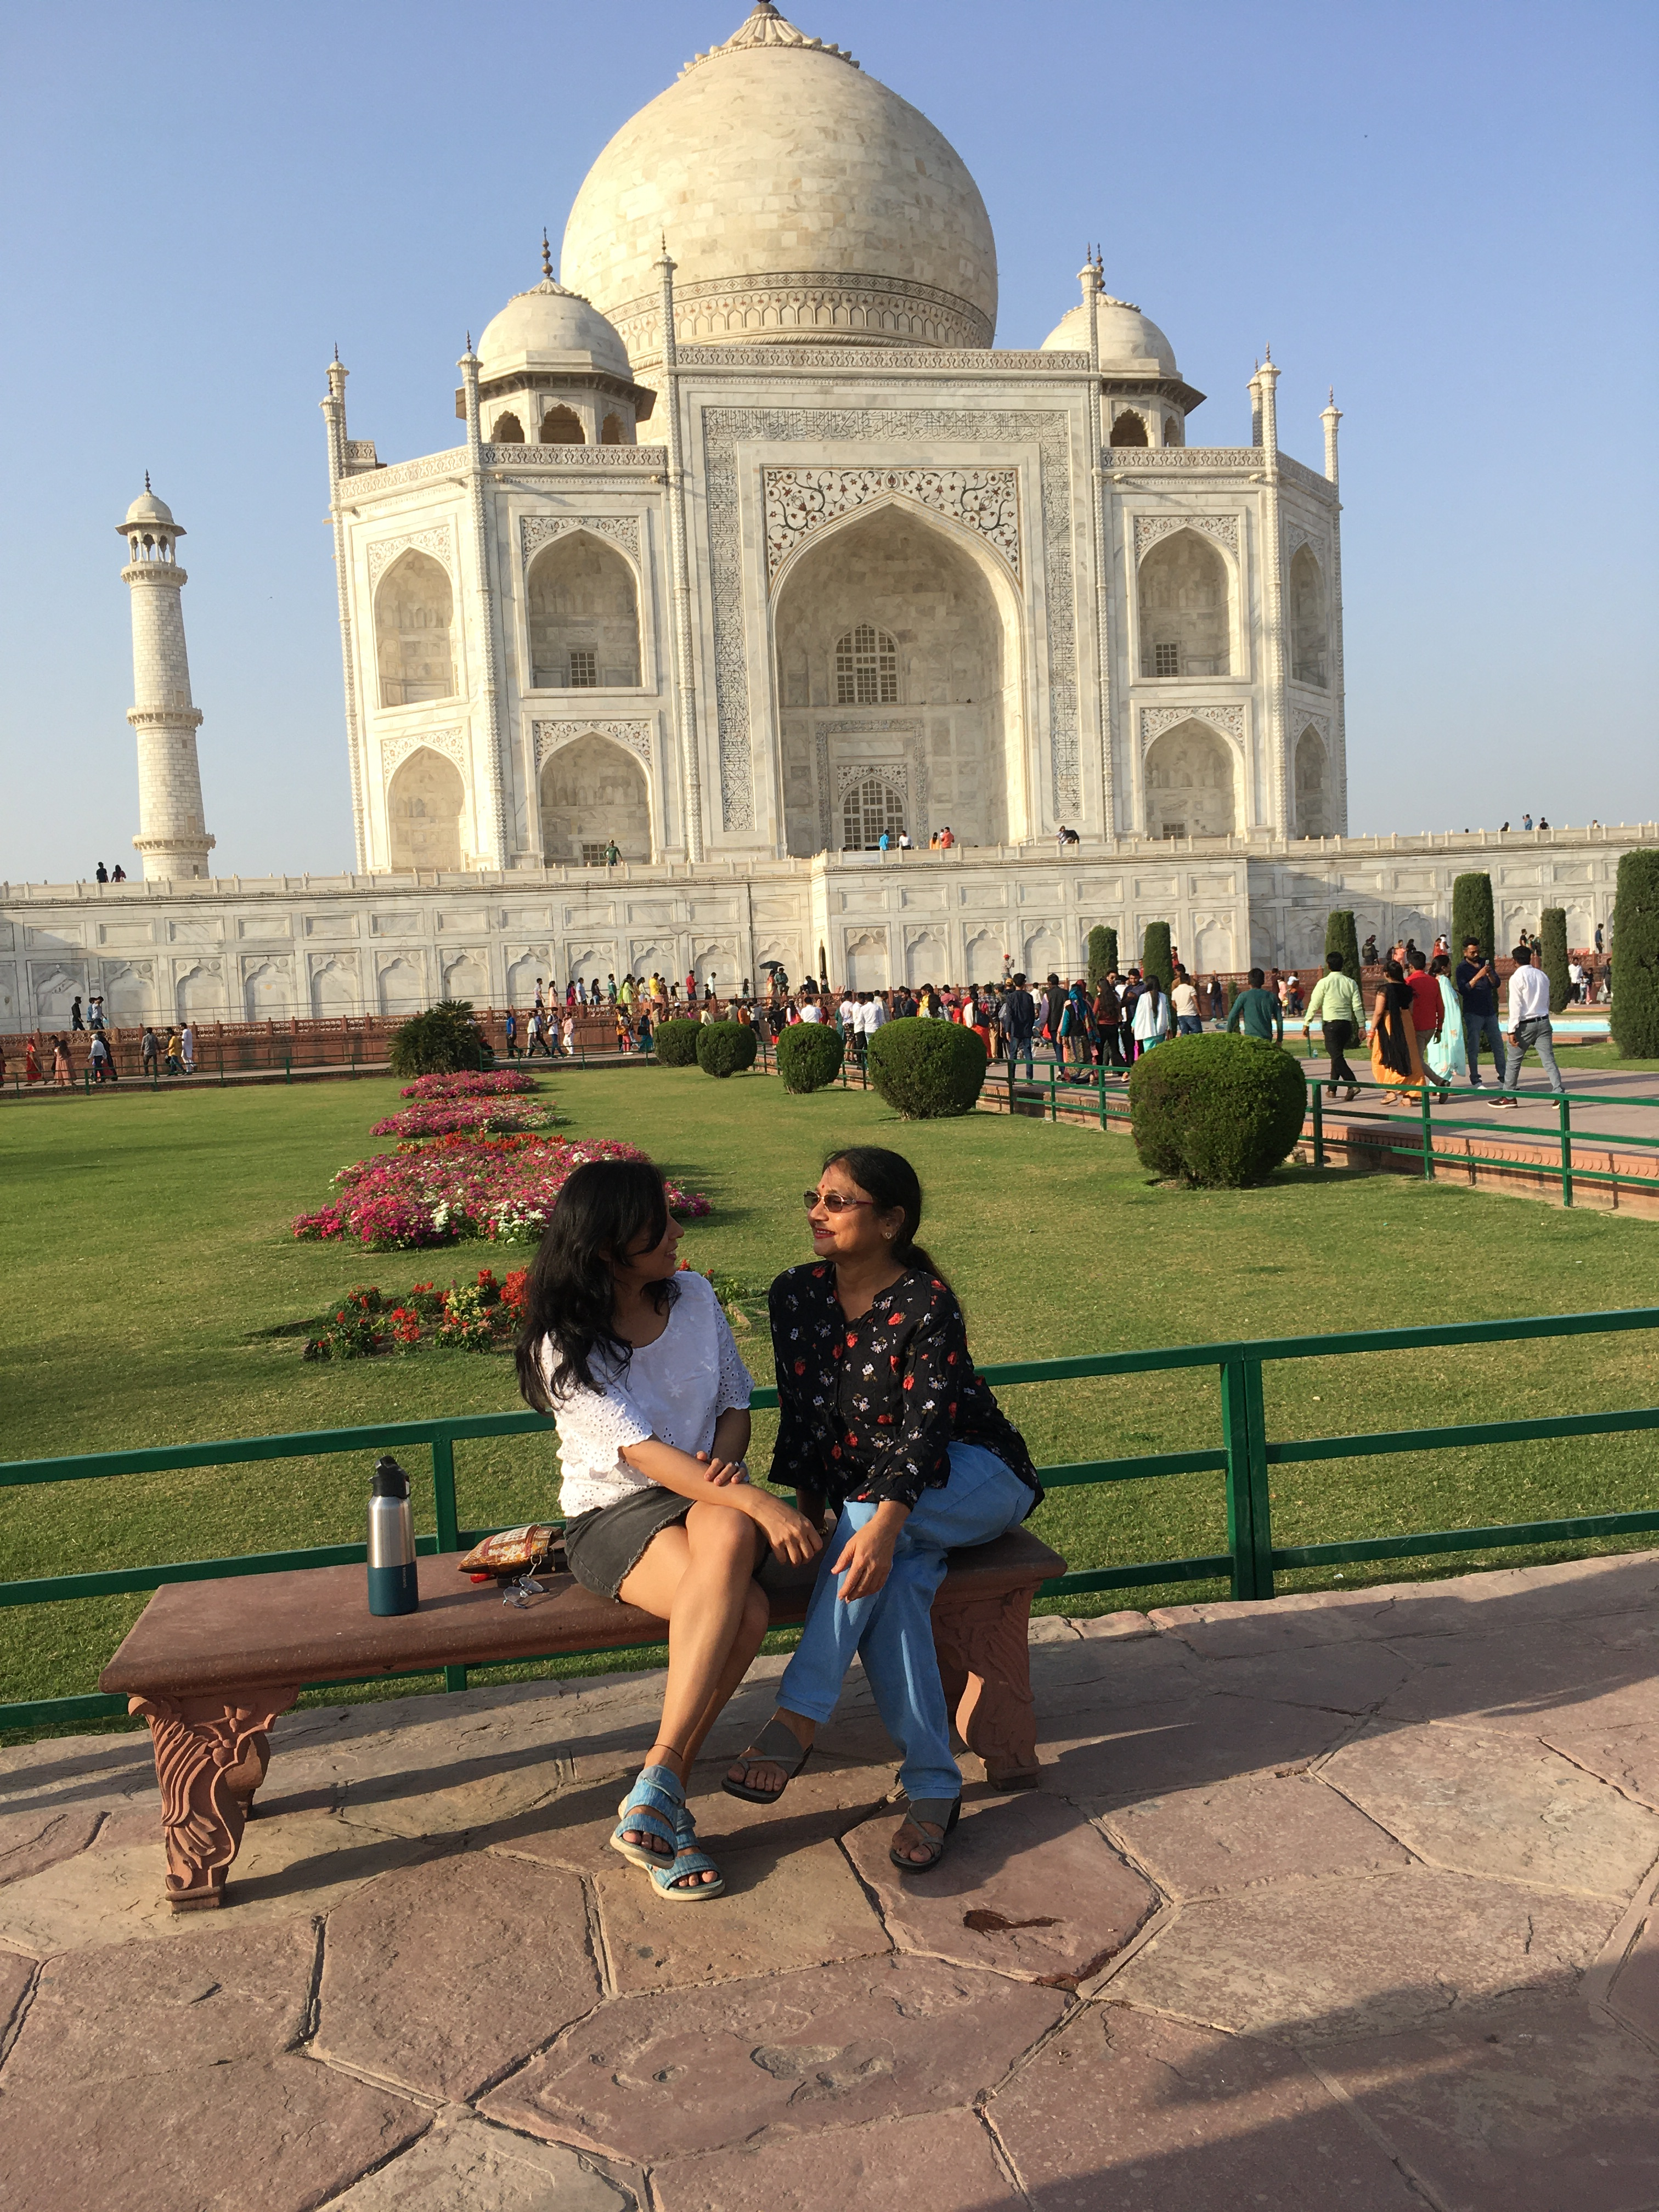


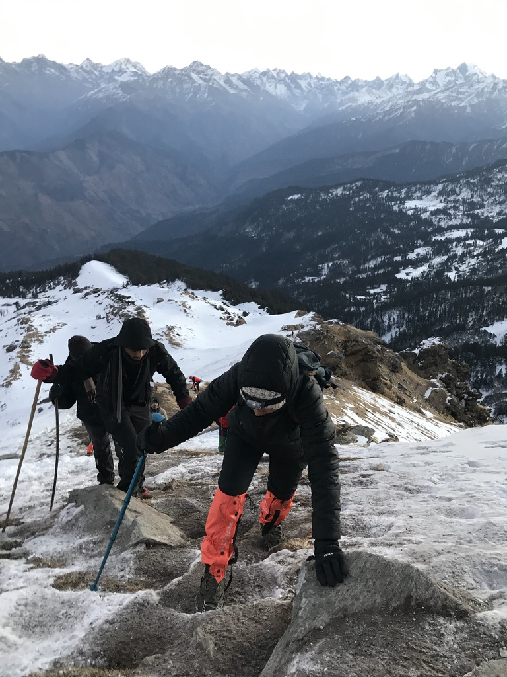
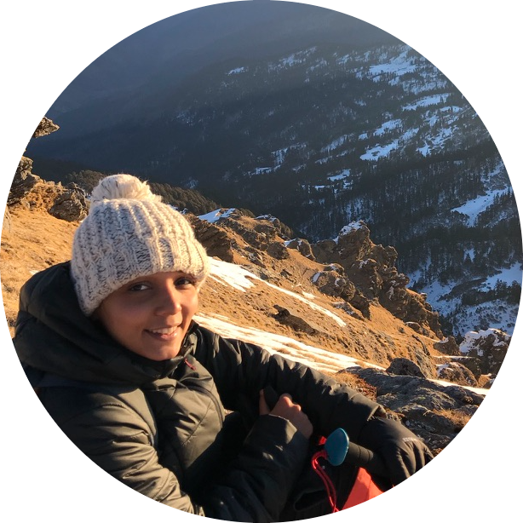


IIOE-2 ECSN
Secretary
2022
ECSN core-committee
2020
PhD 2018
Trainee Scientist 2013
Adjunct Faculty,Regional Centre WMO, India
2019
Scientist
2015
Kedarkanta #12500 ft
2021
B.Tech (CE)
2013
Aditi Modi
(~9 years and counting
@Climate Scientist)

Slide 2
Aditi Modi
(~8 years and counting
@Climate Scientist)

Slide 3
Aditi Modi
(~8 years and counting
@Climate Scientist)

Slide 5
Aditi Modi
(~8 years and counting
@Climate Scientist)

Slide 6
B.Tech (CE)
2013
Aditi Modi
(~8 years and counting
@Climate Scientist)

Slide 7
Trainee Scientist 2013
Aditi Modi
(~8 years and counting
@Climate Scientist)

Slide 8
Scientist
2015
Aditi Modi
(~8 years and counting
@Climate Scientist)

Slide 9
PhD 2018
Aditi Modi
(~8 years and counting
@Climate Scientist)

Slide 10
Adjunct Faculty,Regional Centre WMO, India
2019
Aditi Modi
(~8 years and counting
@Climate Scientist)

Slide 11
ECSN core-committee
2020
Aditi Modi
(~8 years and counting
@Climate Scientist)

Slide 12
Kedarkanta #12500 ft
2021
Aditi Modi
(~8 years and counting
@Climate Scientist)

Slide 14
Kedarkanta #12500 ft
2021
Aditi Modi
(~8 years and counting
@Climate Scientist)

Slide 15
IIOE-2 ECSN
Secretary
2022
Aditi Modi
(~8 years and counting
@Climate Scientist)

Slide 16

IIOE-2 ECSN
Secretary
2022
ECSN core-committee
2020
PhD 2018
Trainee Scientist 2013
Adjunct Faculty,Regional Centre WMO, India
2019
Scientist
2015
Kedarkanta #12500 ft
2021
B.Tech (CE)
2013
Aditi Modi
(~8 years and counting
@Climate Scientist)

